Slide 1
Atmospheric Chemistry Measurements
Jie Zhang
ATM 505 – Lecture 5
Feb 27, 2022

Slide 2
References and Acknowledgements
Books:
  Aerosol Measurement: Principles, Techniques, and Applications. Baron and Willeke, Wiley Interscience (2001)
  Aerosol Technology: Properties, Behavior, and Measurement of Airborne Particles, 2nd Edition, Hinds (1999)
Paper:
  A review of atmospheric aerosol measurements, McMurry, Atmospheric Environment (2000)
Lectures:
  Steven Massie and Jim Smith
  Berko Sierau (for Joel Thorton)

Slide 3
Kinds of Measurements: Research vs Monitoring
Research Measurements
  Address scientific question or problem
  University scientists, private foundations, national labs
  Limited duration (a few weeks to a few months, typically)
  Goal is to write and publish peer-reviewed papers
  Often use state-of-the-art or research methods and measure species that are challenging to capture
Monitoring
  Done to establish compliance with air pollution regulations
  Mainly states, localities, and indigenous nations
  Long Term – often many decades
  Well established methods and commercial instruments
  Limited number of species measured

Slide 4
Measurements of Gas Phase Species
Gaseous Criteria Pollutants (things that are specifically regulated by the Clean Air Act) - monitoring
Greenhouse Gases
Volatile Organic Carbon species (VOCs)
Reactive and short lived species (research measurements)

Slide 5
Satellite vs in situ
Satellite measurements play an increasingly important role
  Measure column density (molecules cm⁻²) and not concentration (molecules cm⁻³)
  Only have good data for a limited number of species (~10)
In situ measurements
  Collect samples and measure true concentrations (mostly)
  Hundreds (thousands?) of sites
  Hundreds of species measured

Slide 6
Methods - Spectroscopy and Chromatography
Spectroscopy – takes advantage of the interaction of light and matter. Chemical substances (atoms and molecules) interact with specific wavelengths of light in ways that allow them to be “fingerprinted”
  Absorption: used for O₃, CO, CO₂, and more
  Fluorescence: used for SO₂, NO₂, Cl, OH, and more
  Chemiluminescence: mainly used for NO (and NO₂)

Slide 7
Chromatography
Gas Chromatography – relies on the slight differences in structure and reactivity of a class of similar species to separate the species in a long, very narrow column coated on the inside with a mildly reactive coating material.
Separated compounds exit the column in “time order” and are detected by one of numerous methods
Detection methods include mass spectrometry, flame ionization, photoionization, electron capture, and numerous others

Slide 8
Matching Species with Methods
Criteria Pollutants: in situ O₃ and CO (Absorption); SO₂ (pulsed fluorescence), and NO/NO₂ (chemiluminescence)
VOCs: Gas chromatography on whole air samples collected in canisters and transported to analysis labs
GHGs: in situ infrared absorption and sample collection with GC; increasingly sensitive laser based IR absorption
Reactive species: often research, one of a kind, and state-of-the-art instruments, laser based, mass spec based

Slide 9
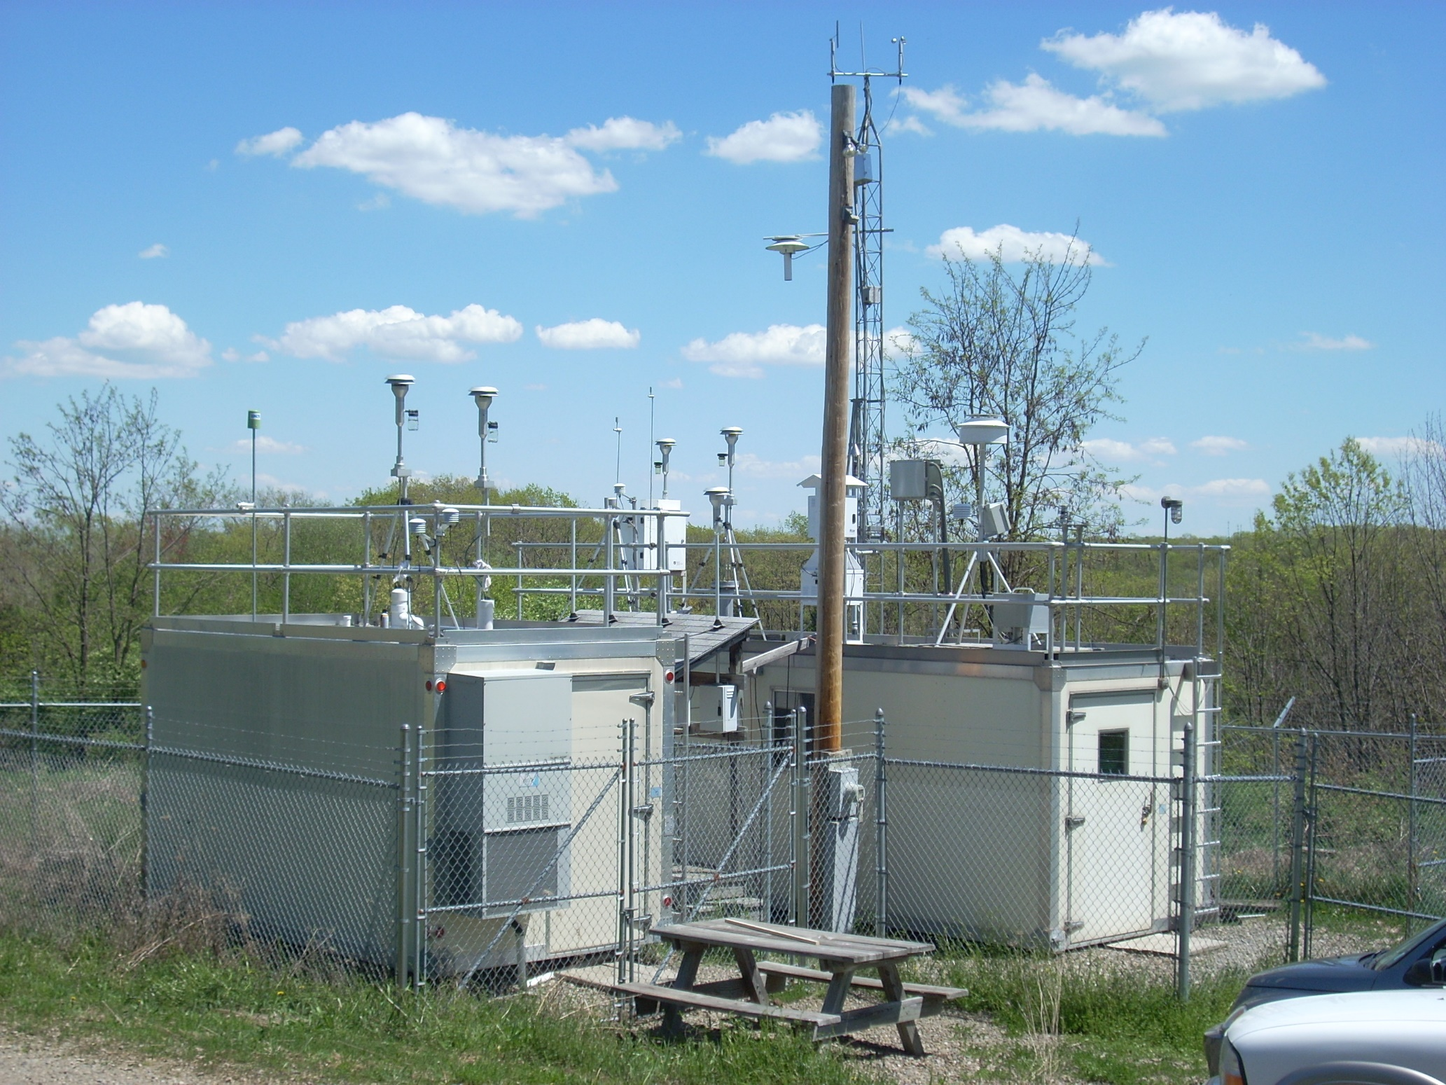

Slide 10
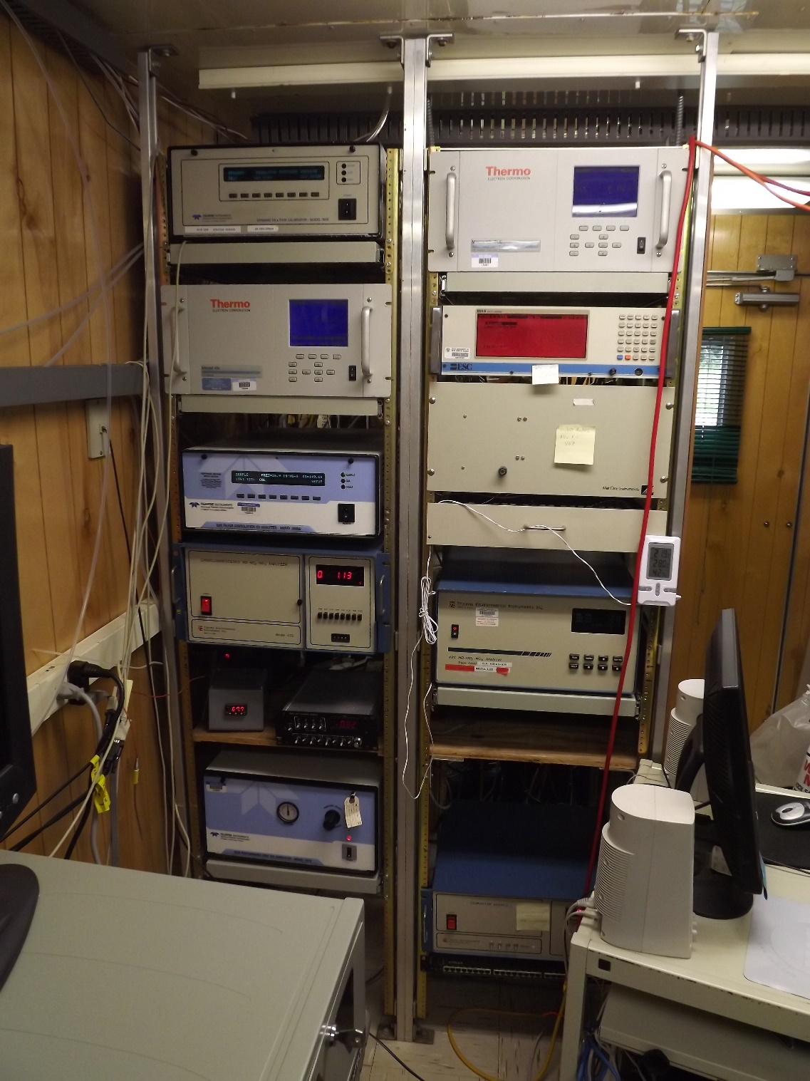
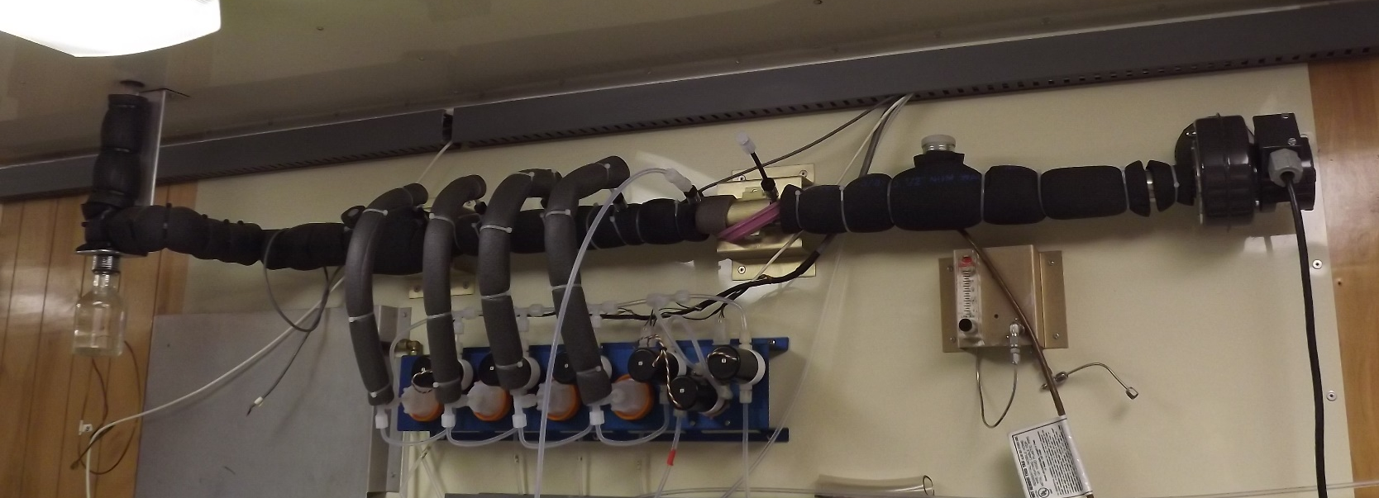
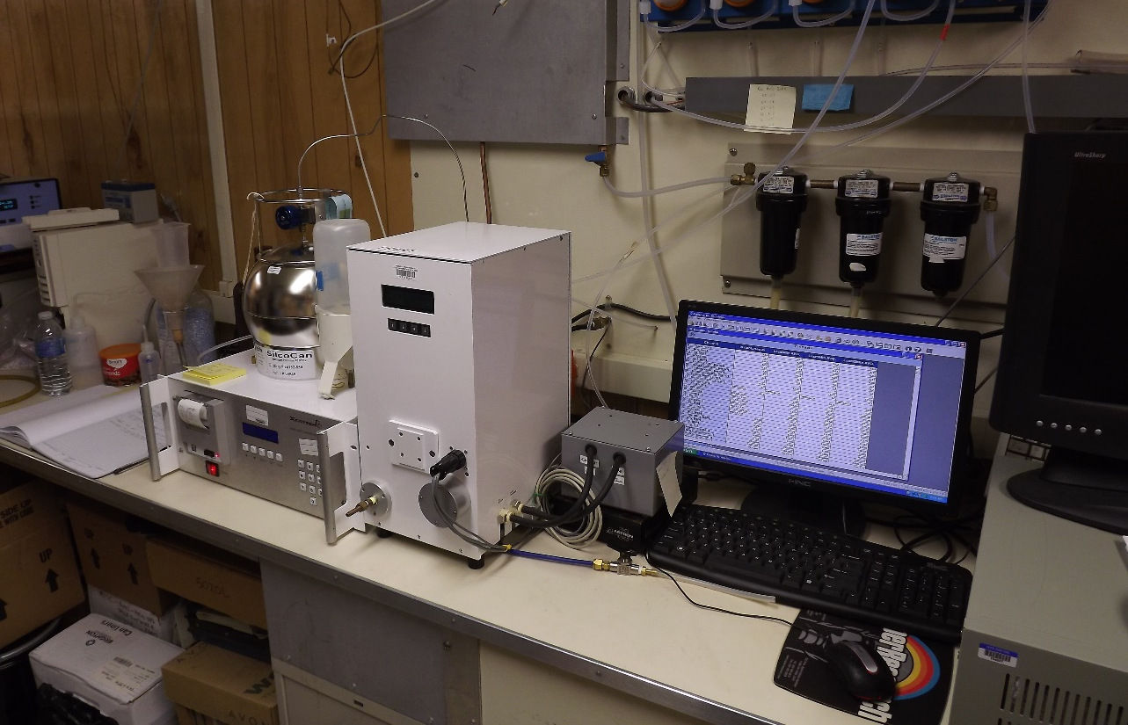

Slide 11
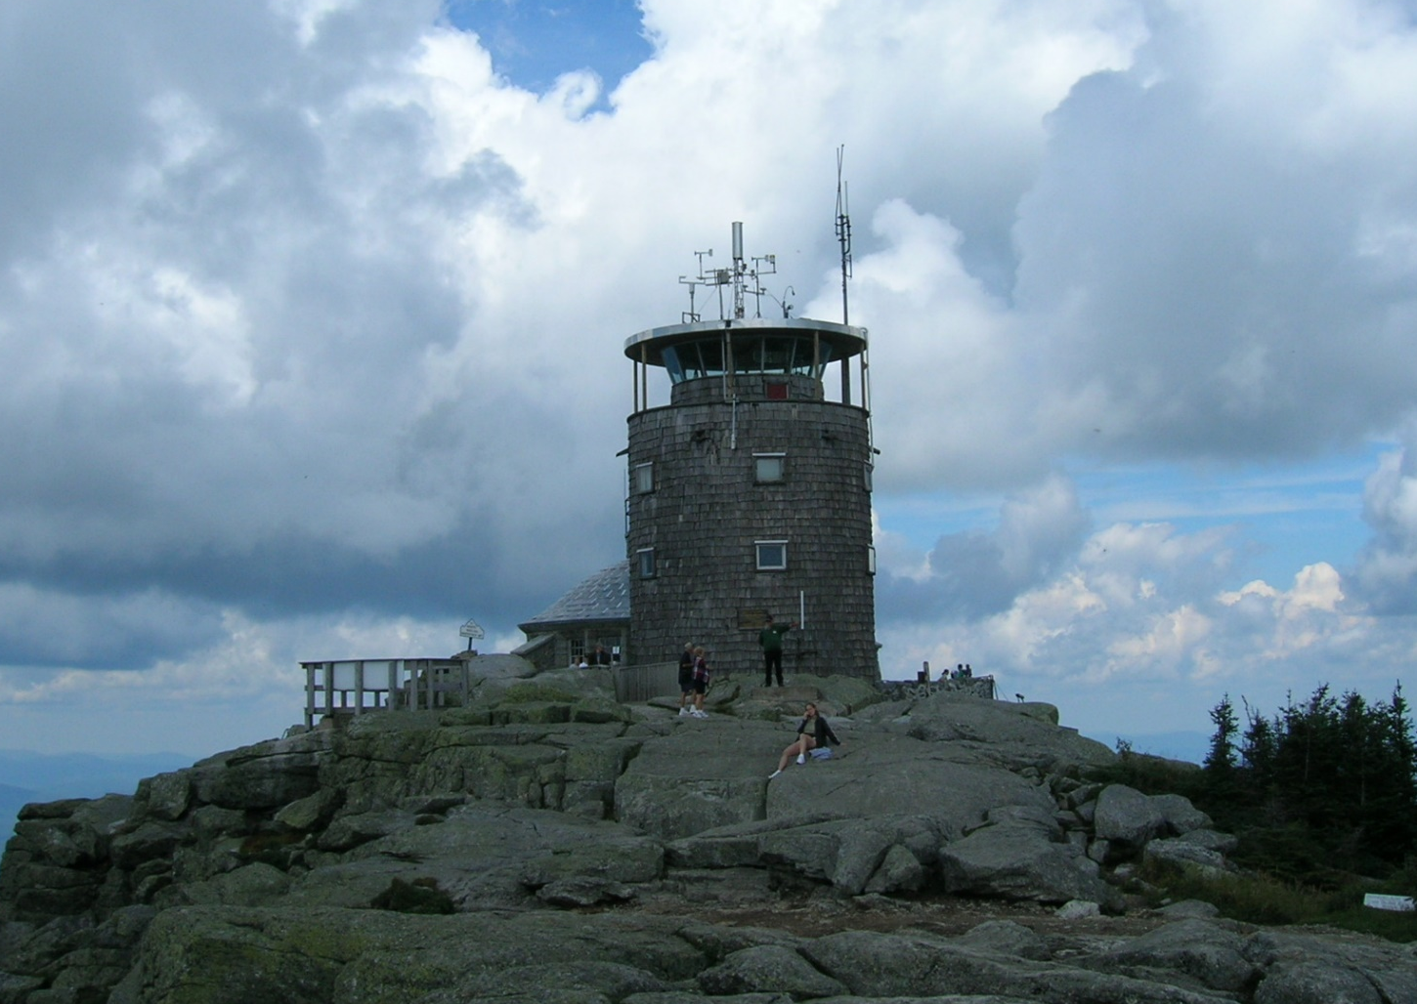
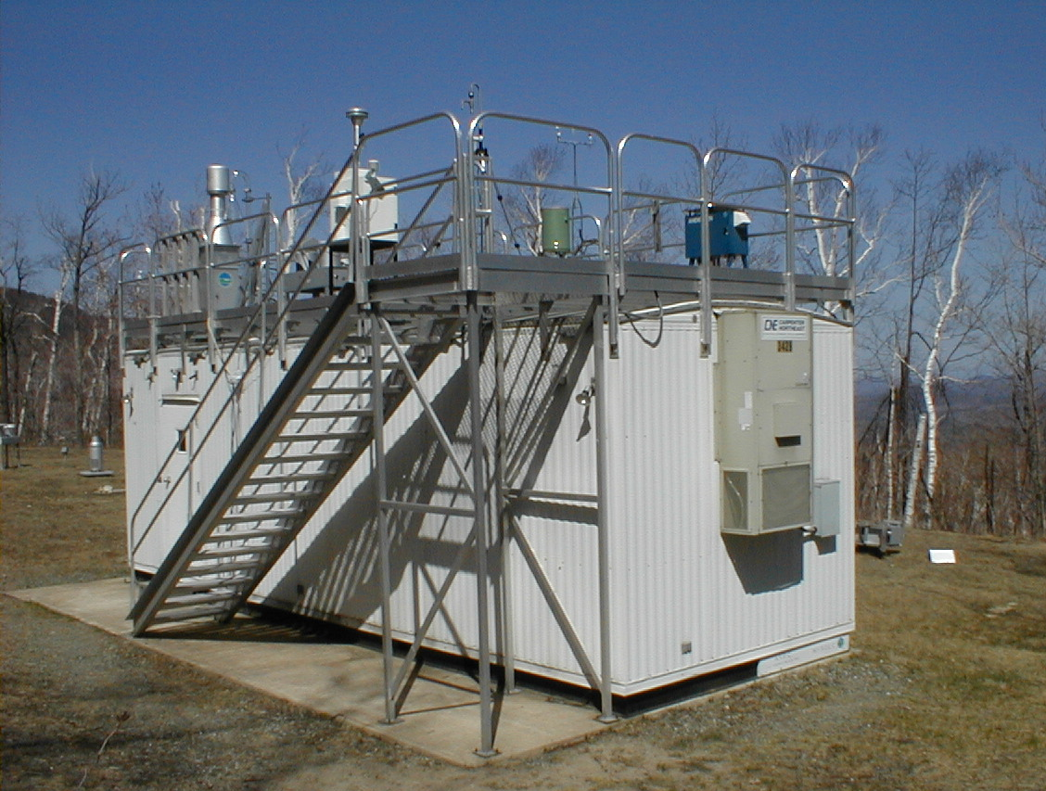

Slide 12
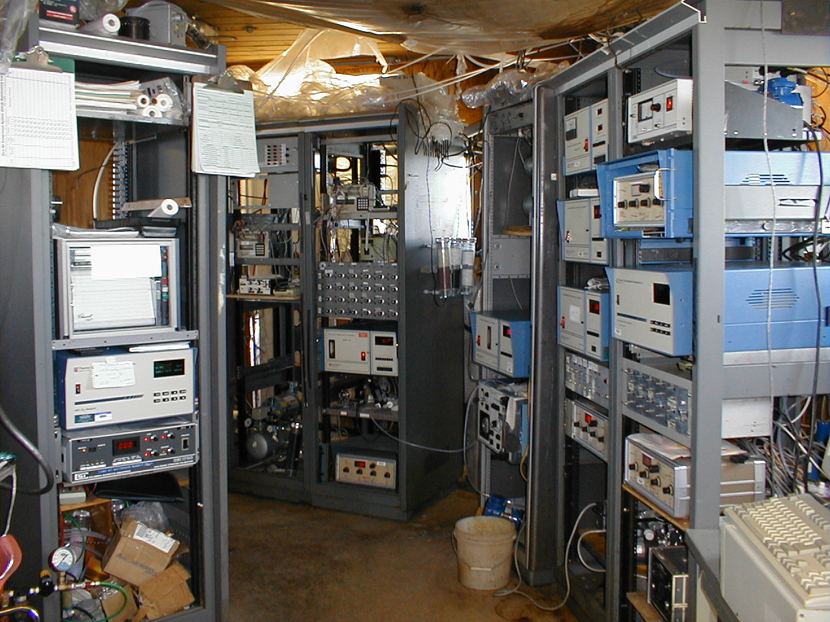

Slide 13
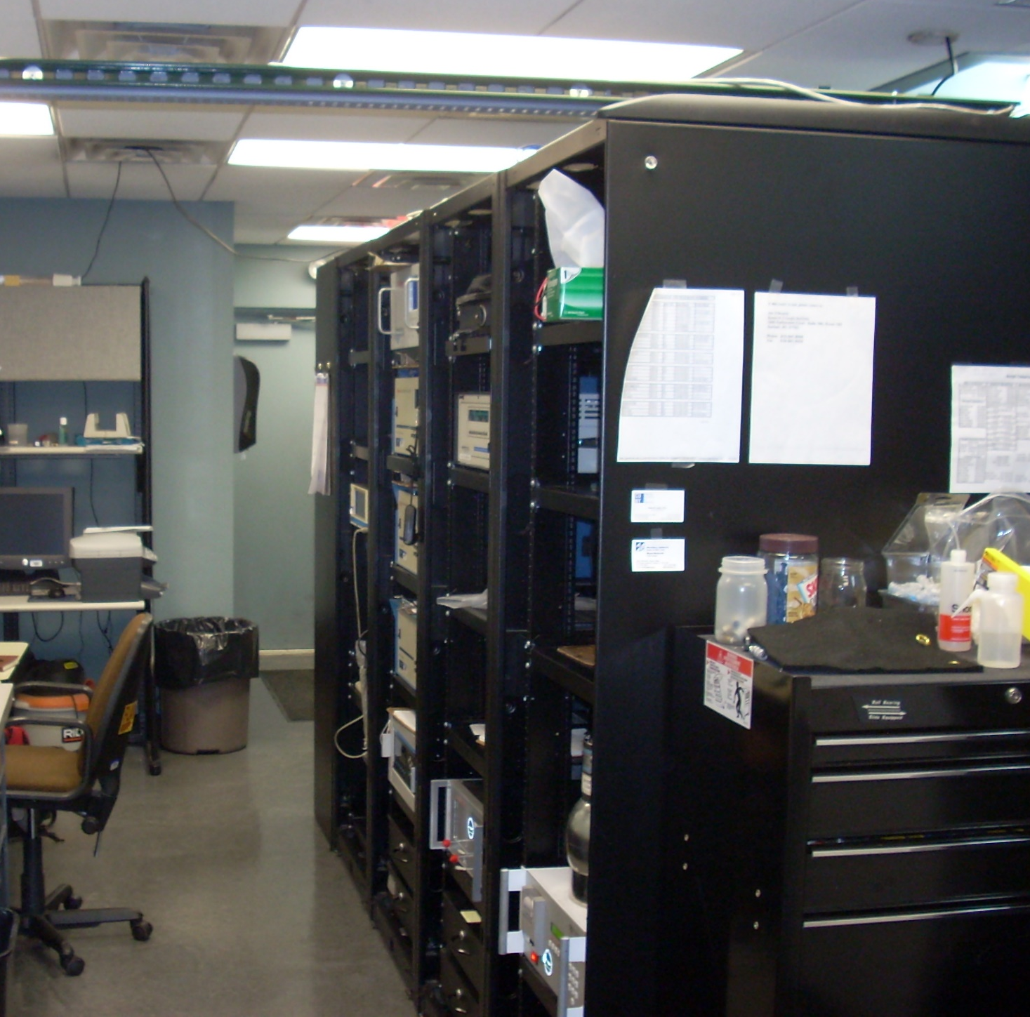
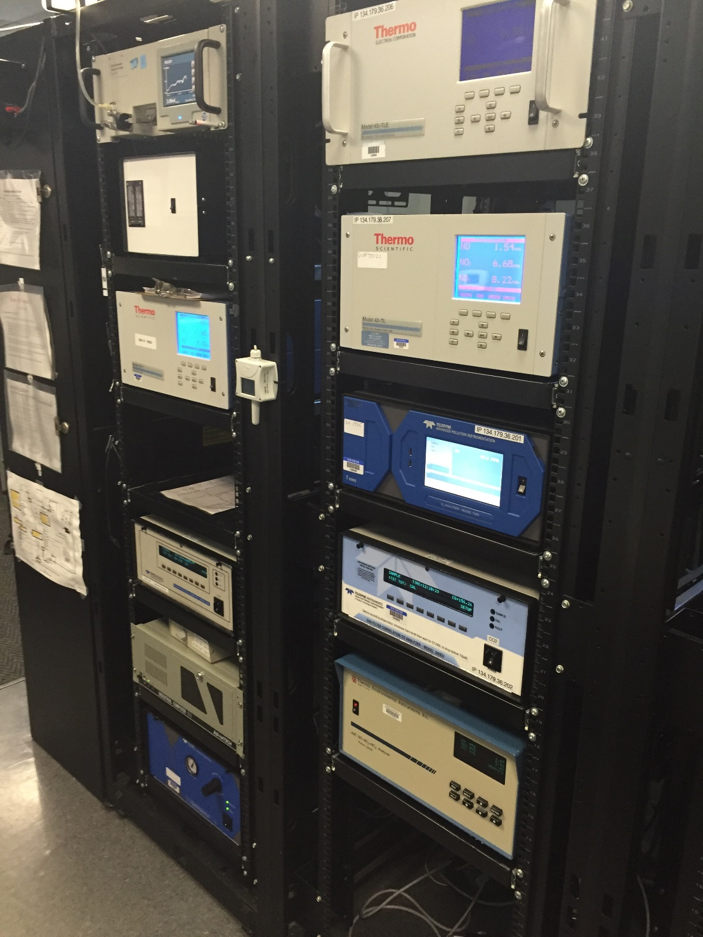

Slide 14
Types of Aerosol Measurements
Aerosol Mass Concentration (regulated quantity – NAAQS)
  Filters (gravimetric)
  Continuous (various)
Physical Properties
  Number Concentration
  Size Distribution
  Shape
  Optical properties –scattering and absorption (index of refraction)
Chemical Composition
  Filters (various)
  Continuous (various)

Slide 15
Mass Concentration
Units are micrograms per cubic meter - µg/m³.
The current US National Ambient Air Quality Standard (NAAQS) regulates PM_{2.5} measured on a teflon filter.
Previous NAAQS regulated first Total Suspended Particles (TSP), then PM₁₀
The gravimetric method (a Federal Reference Method or FRM) is described in great detail, but the result cannot be considered a “true scientific measurement”! (This is due to the complexity of the challenge, and not incompetence.)
Probably the single largest complication is due to aerosol volatility.
In spite of this measurement shortcoming, this data is consistent, reliable, and “actionable” in a regulatory sense.

Slide 16
The FRM – in brief
Filters are specified, inspected and individually stamped with a number.
Filters are conditioned and pre-weighed, put into cassettes – then sent to sampling locations.
Filter cassettes are loaded into samplers that have carefully audited size cutpoint and flow characteristics. They are sampled for 24 hours at the specified flow rate.
After removal from the sampler, filters are kept cool before and during shipment back to the analysis lab (and upon arrival).
At the lab, filters are conditioned as before and weighed.
Mass comes from the difference between the two weighings: flow, temperature and pressure determine the sample volume. Recall - µg/m³.

Slide 17
Continuous Mass Measurements
TEOM – Tapered Element Oscillating Microbalance. Uses the relationship between oscillation frequency and mass to “directly” measure mass changes.
β-attenuation (where β is an electron) – uses measurement of the reduction in intensity of β particles passing through a particle laden filter tape. The relationship between attenuation and particle concentration is “reasonably independent “ of the chemical composition of the atmosphere.
Optical methods – use the physical properties of scattering or extinction (more later).

Slide 18
Schematic of TEOM

Slide 19
Continuous vs. 24-hour Filter Samples

Slide 20
Measurements of Physical Properties
Particle number concentration
Particle Size Distribution (PSD)
Particle Shape (not covered here – not routinely or easily measured)
Optical Properties (A subject unto itself – we will only scratch the surface)

Slide 21
Particle Number Concentration
Aerosol Electrometer – aerosols in the atmosphere have a steady-state charge distribution, that is a mixture of positive, negative, and (mostly) neutral charges. If this distribution is known and can be described – and it often is and can be – then a sensitive electrometer can measure total aerosol concentration.
Condensation Particle Counter (CPC) – easiest and most reliable method.

Slide 22
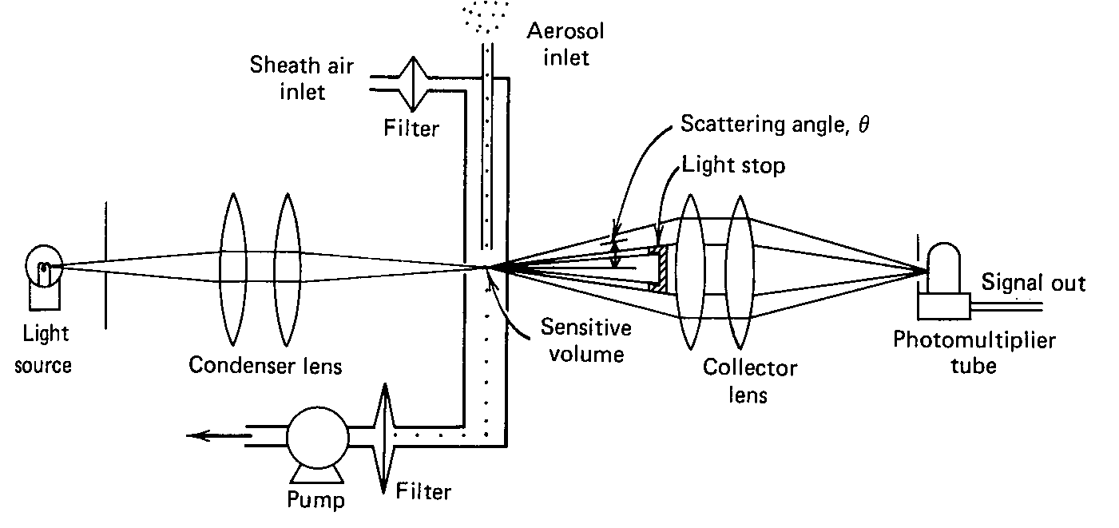
Optical Particle Counter (OPC): ~ 100 nm to 5 μm
Size limits defined by Mie scattering, and Mie scattering theory is used to interpret integrated scattered intensity.
Advantages: Can detect small particles (but not the smallest) Non-intrusive Instantaneous and continuous information | Disadvantages: too sensitive to small changes in refractive index scattering angle particle size particle shape

Slide 23
Condensation Particle Counter
Saturate an aerosol with water or alcohol vapor
Cool by adiabatic expansion or flow through a cold tube
(can also heat in some cases, the temperature gradient is the key)
Nuclei will grow to ~ 10 μm (particles this size will scatter visible light with good efficiency)
Every condensable nuclei grows to a (small 10-12 µm) droplet
Measure the number of droplets with an e.g. single particle optical counter

Slide 24
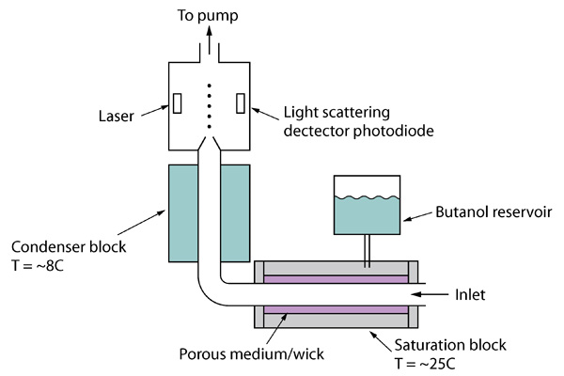
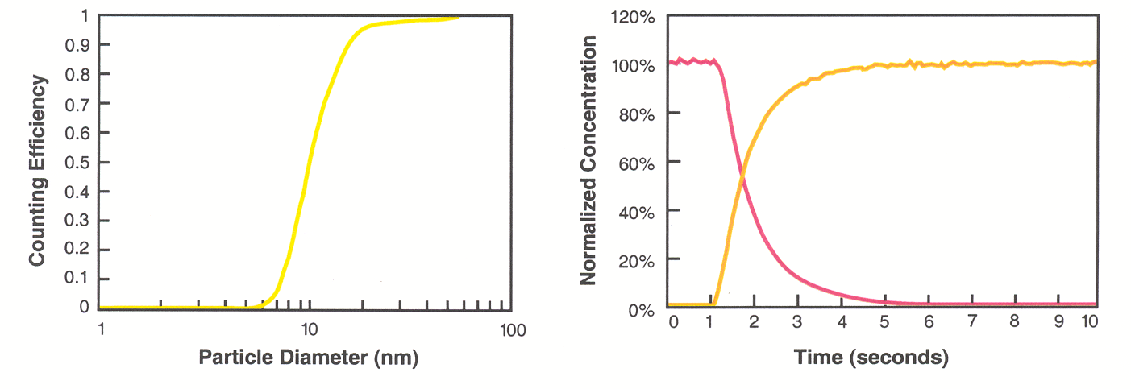
Condensation Particle Counter (CPC): ~1.5 nm to 0.5 μm ambient aerosol size range
Condensation Particle Counters (CPCs) detects particles by exposing them to a region that is supersaturated with vapor (usually butanol), thus allowing particles to grow to a size that can be optically detected.
Counting efficiency curve: TSI model 3010
Response time: TSI model 3010

Slide 25
Particle Size Distribution
Impactor – relies on inertial characteristics of particles (i.e., larger, more massive particles have greater inertia)
Differential Mobility Analyzer – creates steady-state charge distribution and balance mass and charge as aerosols flow through an electric field

Slide 26
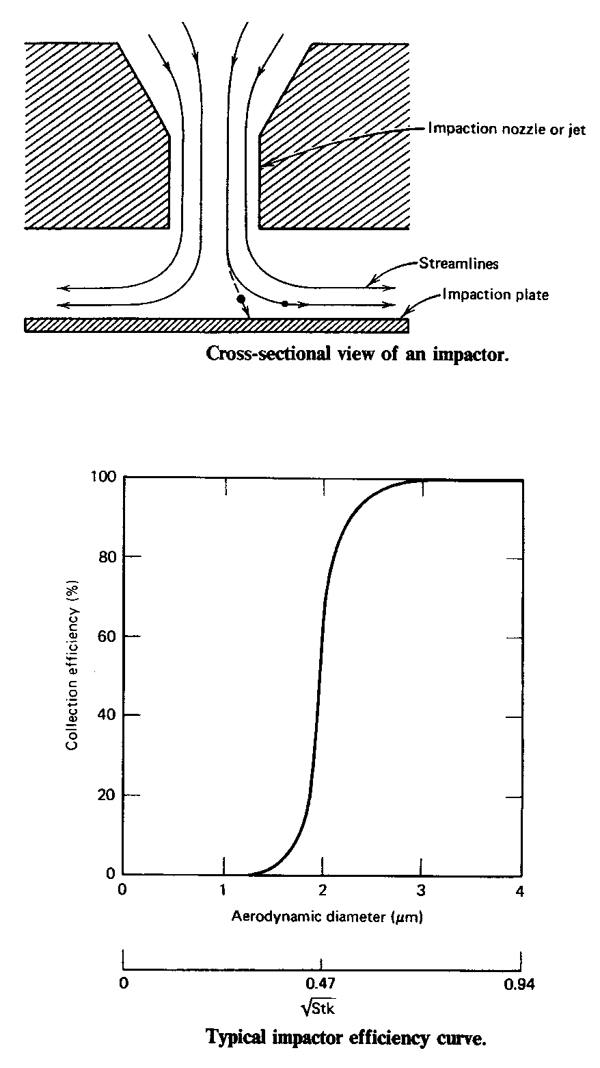

Slide 27
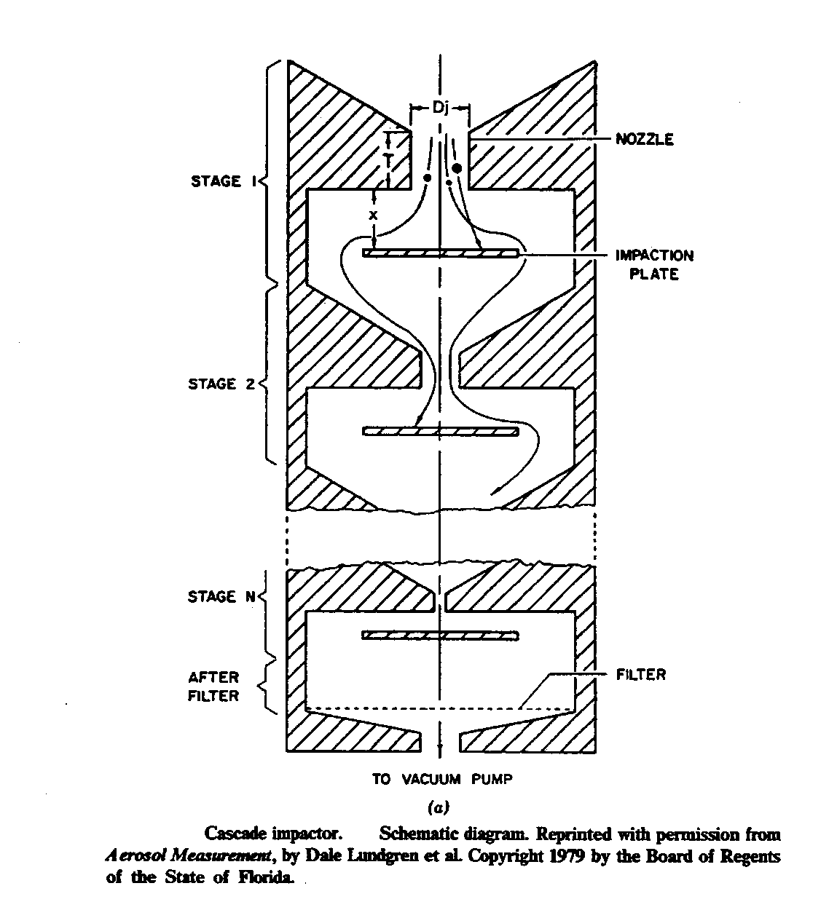
Two things are changing with each stage:
Diameter of nozzle
Distance from nozzle to impactor plate
To decrease the cut-off diameter from stage to stage is achieved by
a) decreasing the nozzle diameters (increase in particle/air velocity)
b) and/or decreasing the number of nozzles
c) and/or decreasing the pressure (increase in slip correction).

Slide 28
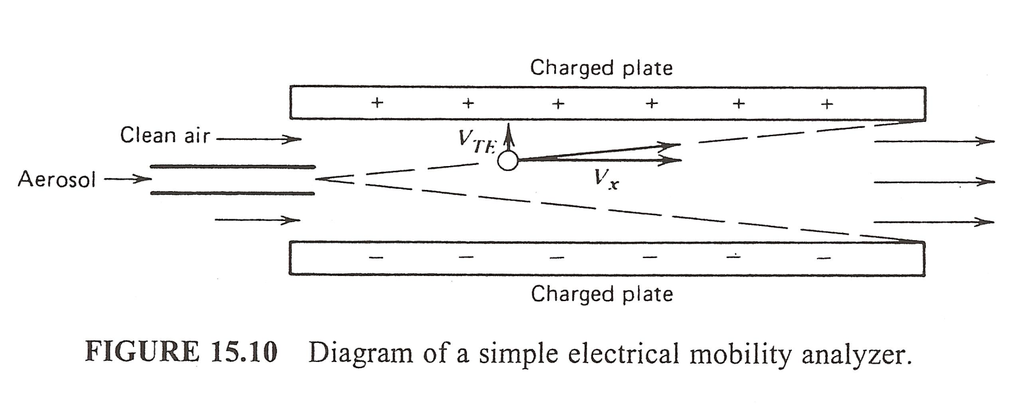
DMA - Differential Mobility Analyzer
A charged particle will be pushed in the direction of V_{TE} by the
electric field E between the two plates.
Hinds

Slide 30
Aerosol Chemical Composition
National networks include CSN (Chemical Speciation Network) –mostly urban locations; and IMPROVE – mostly rural & remote locations
Like with Mass Concentration, the routine network measurements are 24 hour samples collected on filters and analyzed post-sampling in the laboratory. Many networks collect three different filters:
A Teflon filter which is analyzed for total mass and elements using XRF (X-Ray Fluorescence)
A Nylon filter (preceeded by gas denuders) which is “digested” and analyzed for major ionic species (i.e., sulfate, nitrate, ammonium, etc.)
A pre-baked quartz filter which is analyzed for total carbonaceous material and the empirically defined Elemental Carbon (EC) and Organic Carbon (OC) fractions.

Slide 31
Continuous Chemical Composition
Mass Spectrometry (many types, very active research field) – next slides
Particle- Into Liquid-Sampling (PILS) – can be couple with Ion Chromatography, Total Organic Carbon detection, etc.
A variety of analyzers or systems for one or more chemical fraction, like carbon, sulfate, or nitrate.

Slide 32
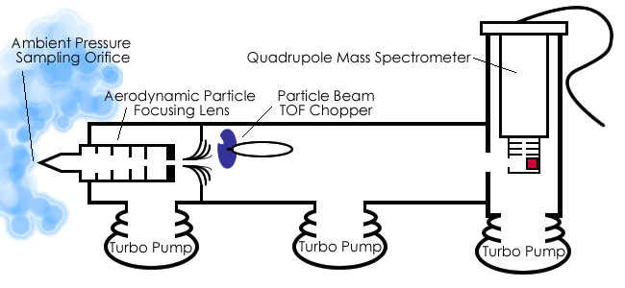
Aerosol Mass Spectrometer (AMS)
For an excellent review of this and other instruments that measure aerosol composition using mass spectrometry see:
  http://cires.colorado.edu/~jjose/Papers/2010-09_IAC_Aerosol_MS_Tutorial.pdf
  Aerodyne Research, Incorporated

Slide 33
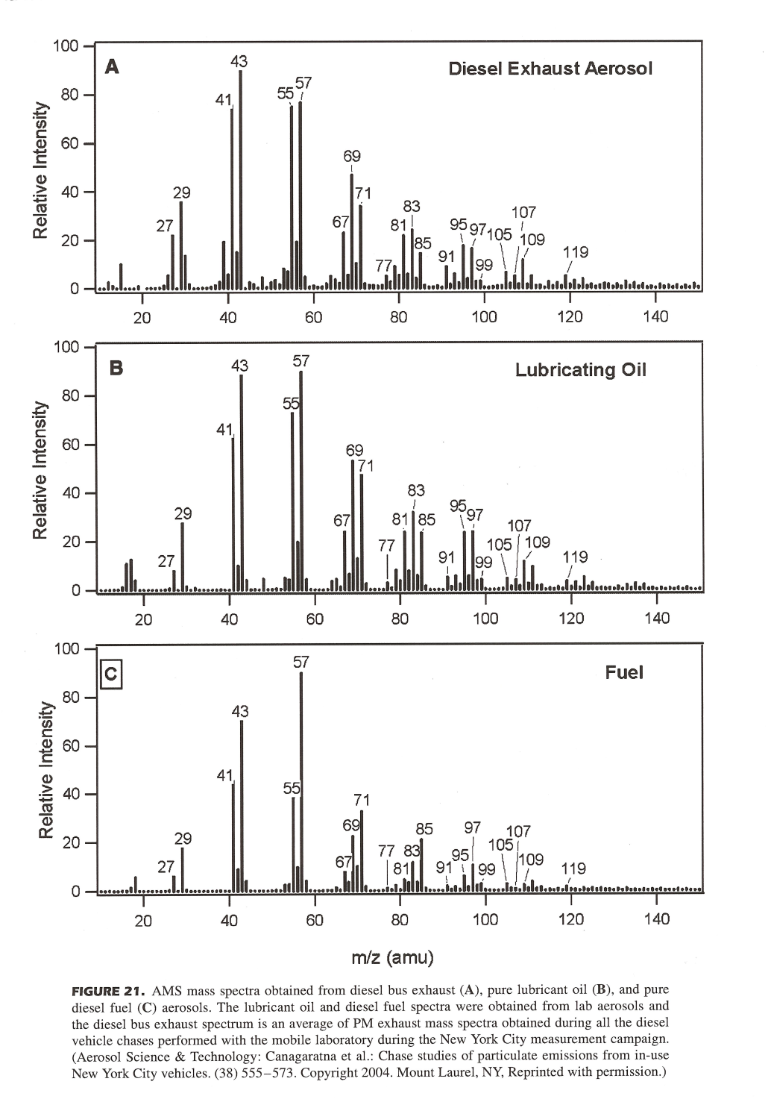
Field observations
Lab
Lab
Canagaratna et al.,
Mass Spec Rev, v26,
P185-222,2007.

Slide 34
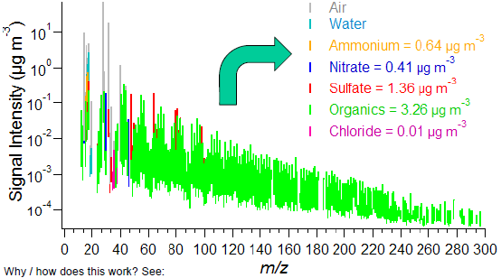
AMS mass spectrum from ambient aerosol
Since the AMS uses electron impact ionization and high temperature, species are modified as they are desorbed and ionized.
Luckily, marker species and co-varying peaks can be found that uniquely identify compound classes.
A high-resolution Time-Of-Flight Mass Spectrometer (TOFMS) has been developed for use with the AMS, thus allowing for elemental analyses such as C:O. In the TOFMS, an E field accelerates ions of different mass to the same kinetic energy ½ m v². Larger mass ions travel at slower v than lighter ions. For each ion, measure the travel time between two laser beams, get v, and then m.

